Slide 1
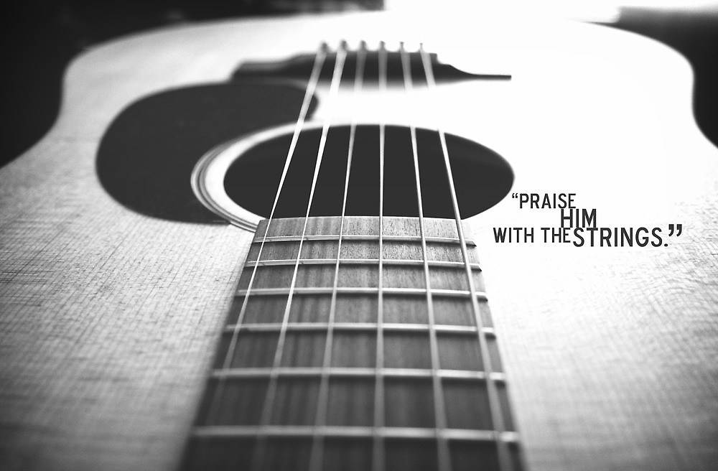

Slide 2
GUITAR 101 The BEGINNER COURSE : week 3

Slide 3
Part 1 : week 2 review

Slide 4
Sound difference between minor & major chords
Major chord has cheerier and brighter sound
Minor chord has sadder and darker sound
Only one note differs between them – the “3rd note (which will be discussed in later topics)”

Slide 5
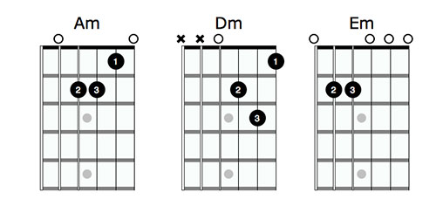
Your first minor chords: the Open minor chords

Slide 6
Your chord portfolio
CAGED
Dm, Am and Em
Bonus : Bm, C#m, F#m

Slide 7
Part 2: basic strumming patterns

Slide 8
strumming
Strum or Stroke is a sweeping action where a fingernail or plectrum brushes past several strings in order to set them all into motion and thereby play a chord.
Strums are contrasted with plucking.
In plucking, only one string is played at a time.

Slide 9
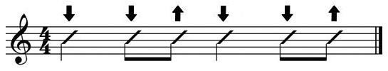

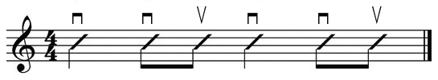
notations
Arrow Notation
Letter Notation
Traditional Notation

Slide 10
Basic rhythms
Whole note
1 note in 4 counts
Half note
2 notes in 4 counts
Quarter note
4 notes in 4 counts
Eight note
8 notes in 4 counts
Exercises : Arm swinging using the notes

Slide 11
Part 3 : bar chords

Slide 12
Barre chords
Barre chords are chords that involve using one finger, usually your first finger, to press all the strings down at once on a single fret.
Barring turns your first finger into a movable capo.
You can then use your remaining three fingers to play open chord shapes, but in any position on the fretboard.

Slide 13
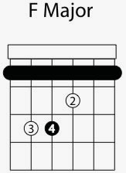
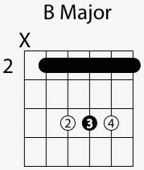
Your first barre chords : F and B Major
E shape
A shape

Slide 14
Your chord portfolio
Open Chords
CAGED
Dm, Am and Em
Barre Chords

